Slide 1
V&V Challenges in the Aerospace and Food Industries
Dr. Dejanira Araiza Illan
Development Scientist
Advanced Remanufacturing and Technology Centre (ARTC)
A*STAR (Singapore)

Slide 2
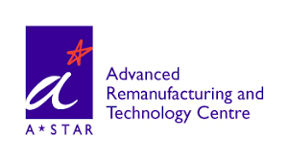
Remanufacturing
Manufacturing
Industry 4.0

Slide 3
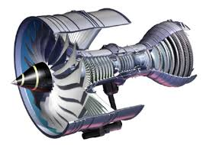

Part-to-part variation
Highly customized processes (remanufacturing)
Different components every day
Aerospace Industry
Components and processes originally made for human operators → design changes are not easily accepted
Well defined standards

Slide 4
Many processes are manual
Highly customized
Food industry
Goods can change constantly
Robots used for several different processes according to demand
Different materials, shapes and forms (challenging to manipulate)

Slide 5
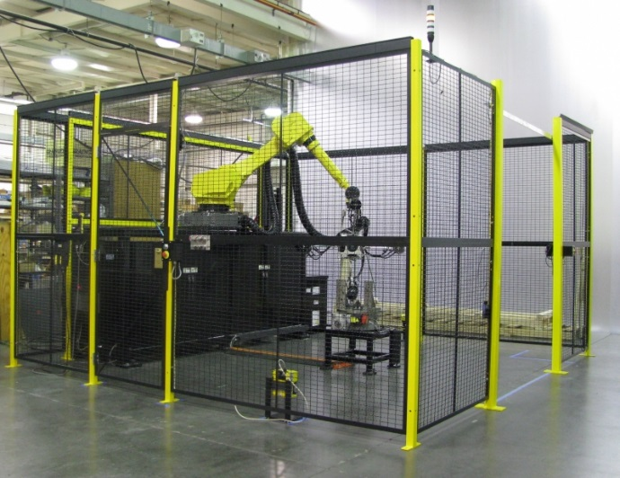
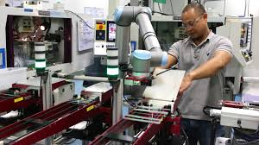
V&V Challenges: Human Safety
Traditional industrial robots
Collaborative robots (cobots)
More sensors + intelligence -> prevent hazards to operator
More intelligence -> use in many processes and flexible production lines
Simplified programming -> fast reconfiguration
V&V for systems that learn/change
Sensors + system = operator’s safety (how to prove this)
Re-programming shouldn’t delete the knowledge
Re-programming shouldn’t introduce harmful situations

Slide 6
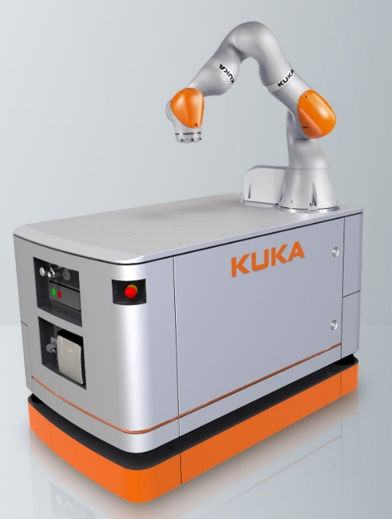
V&V Challenges: Human Safety
Mobile manipulator
No safety standard for this type of robots
How to V&V a manipulator-AGV system?

Slide 7
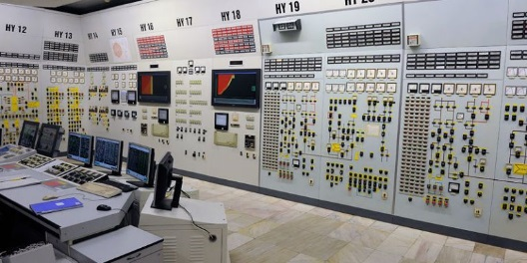
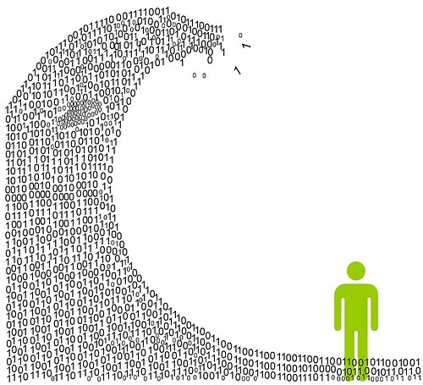
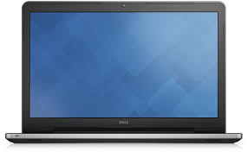
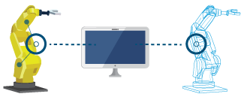
V&V Challenges: Industry 4.0
Data
Automated control of everything
Digital twins
How to protect data? (Do we even need all of it?)
How to ensure the automatic control is working correctly?
How to prove the digital twin is a correct representation of the real?
Security against attacks and intrusions?

Slide 8
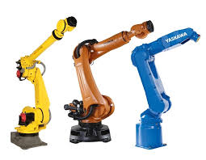

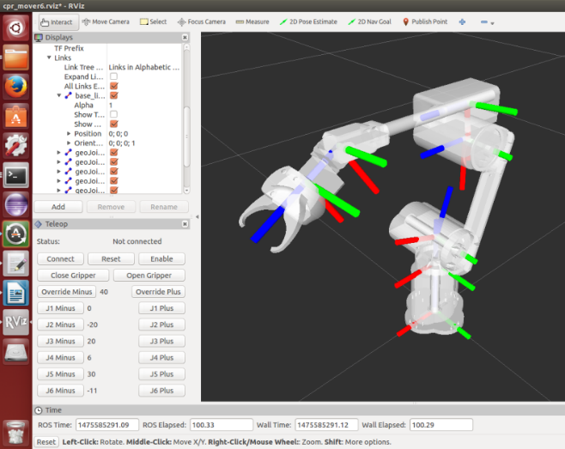
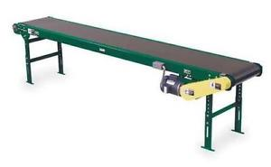
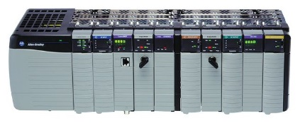
V&V Challenges: Intellectual Property
Black box 1
Black box 2
Black box 3
Theory
Practice
Modular and open-source software platforms to program all brands and models (e.g. ROS)
Concurrency and serialization?
How to protect the IP and be open at the same time?
How to ensure open-source libraries preserve the integrity of the equipment?

Slide 9
Thank you

