Slide 1
Verification of Learning Systems:
“Trust, but Verify”
  Donald Sofge, Code 5514
  Email: don.sofge@nrl.navy.mil
  Distributed Autonomous Systems Group
  U.S. Naval Research Laboratory
  don.sofge@nrl.navy.mil
  ICRA2018 Presentation, Third Workshop on Verification of Autonomous Systems, 25MAY2018
Notes:
From Russian proverb: Doveryai, no proveryai

Slide 2
Overview
What is the problem with autonomous systems making decisions?
Establishing trust in autonomy
Approaches to verification
Offline versus on-line learning
Panel Introductions
Questions for the panel and audience

Slide 3
The Problem
Google Employees Resign in Protest Against Pentagon Contract
Kate Conger, 5/14/18
Gizmodo
“Google is helping the Defense Department implement machine learning to classify images gathered by drones. But some employees believe humans, not algorithms, should be responsible for this sensitive and potentially lethal work—and that Google shouldn’t be involved in military work at all.”

Slide 4
The Problem
“A Google spokesperson told Gizmodo that the company was in the process of drafting ‘policies and safeguards’ around its use of machine learning, but that policy document has yet to materialize, sources said.
Google has emphasized that its AI is not being used to kill, but the use of artificial intelligence in the Pentagon’s drone program still raises complex ethical and moral issues for tech workers and for academics who study the field of machine learning.”
“Any military use of machine learning naturally raises valid concerns.”
— Google spokesman

Slide 5
Trust
Timeline
2009: Appointed to C3I TTCP panel on Planning and Scheduling (TP4)
--- Pushes work on Autonomous Systems to P&S
2011: Selected to Chair new TTCP Action Group on Autonomy (AG-1)
2012: Trustable Autonomy selected as keystone topic for AG-1
2012: Led Panel on Planning & Scheduling for Autonomous Systems
at Knowledge Systems for Coalition Operations Conference
(KSCO2012)

Slide 6

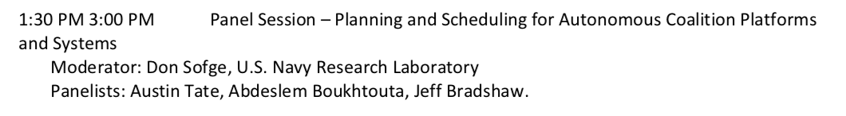
Trust

Slide 7
Trust
Timeline
2012: Served as Advisor to 2012 OSD DSB Summer Study on Autonomy
2013: Co-organized AAAI Spring Symposium on Trust and Autonomous Systems
Gave Presentation at DARPA HQ “Developing Trust in Autonomous Systems”

Slide 8


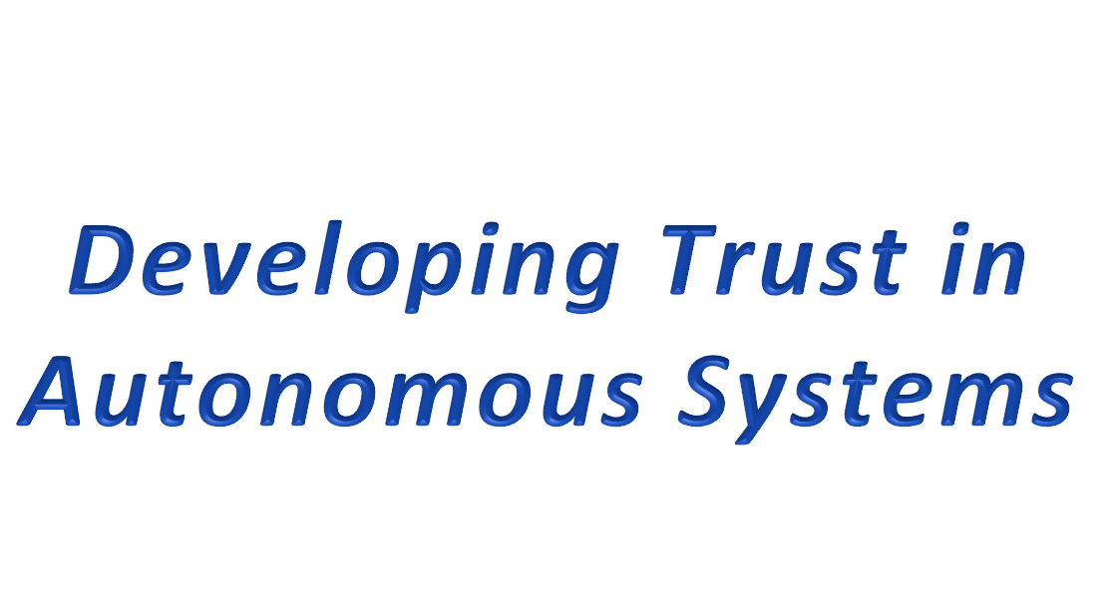
Don Sofge
Code 55 4 (Natural Computation Group)
Navy Center for Applied Research in Artiﬁcial Intelligence
Naval Research Laboratory, Washington D.C.
don.sofge@nrl.navy.mil
May 7, 2 0 1 3

Slide 9
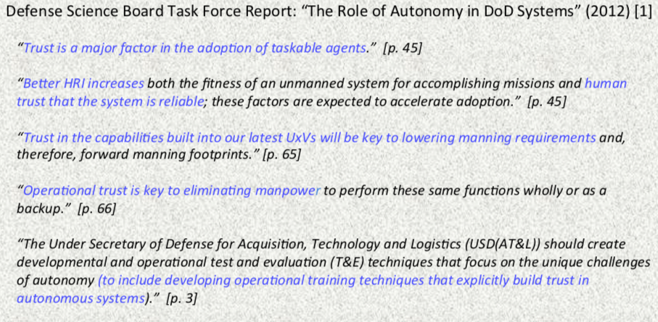
Lack of trust hampers adoption of autonomous systems by DoD
Importance of Trust Development

Slide 10
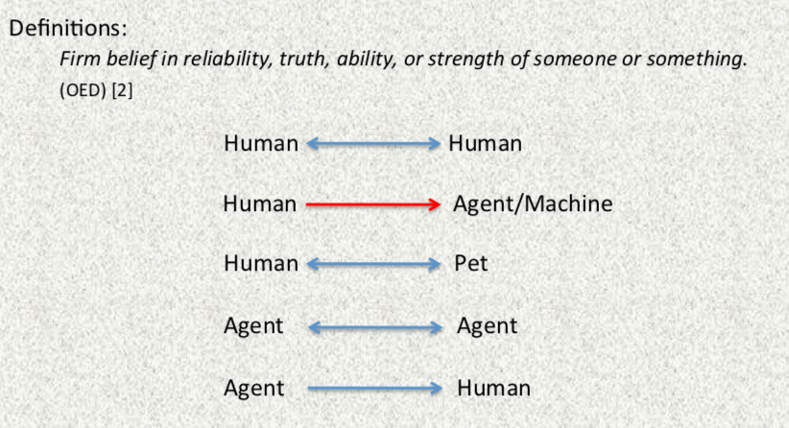
Trust Agencies (for example)

Slide 11
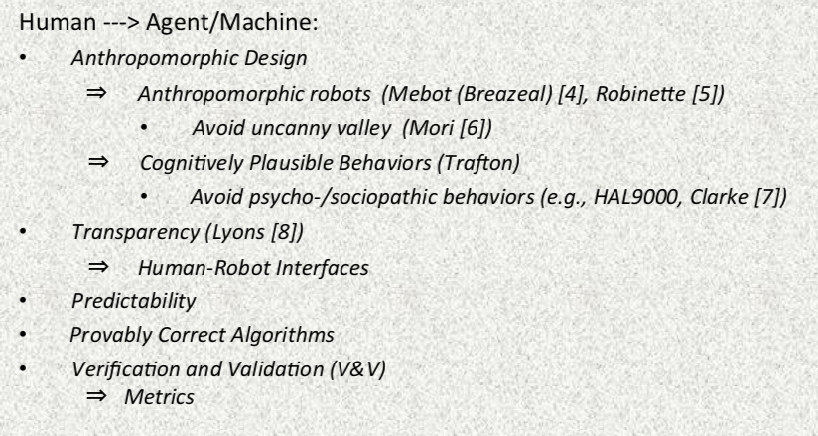
Establishing Trust

Slide 12
Trust
Timeline
2014: Co-organized AAAI Spring Symposium on “The Intersection of Robust
Intelligence and Trust in Autonomous Systems”
2015: Served as Advisor to 2015 OSD DSB Summer Study on Autonomy
2016: Springer publishes ‘Robust Intelligence and Trust in Autonomous Systems”

Slide 13
Trust
Mittu, Ranjeev, Donald Sofge, Alan Wagner, and William Frere Lawless, eds. Robust Intelligence and Trust in Autonomous Systems. Springer US, 2016.
Description:
This volume explores the intersection of robust intelligence (RI) and trust in autonomous systems across multiple contexts among autonomous hybrid systems, where hybrids are arbitrary combinations of humans, machines and robots. To better understand the relationships between artificial intelligence (AI) and RI in a way that promotes trust between autonomous systems and human users, this book explores the underlying theory, mathematics, computational models, and field applications. It uniquely unifies the fields of RI and trust and frames it in a broader context, namely the effective integration of human-autonomous systems.

Slide 14

Trust
Lawless, W. F., Ranjeev Mittu, Donald Sofge, and Stephen Russell, eds. Autonomy and Artificial Intelligence: A Threat or Savior?. Springer, 2017.
Description:
This book explores how Artificial Intelligence (AI), by leading to an increase in the autonomy of machines and robots, is offering opportunities for an expanded but uncertain impact on society by humans, machines, and robots. To help readers better understand the relationships between AI, autonomy, humans and machines that will help society reduce human errors in the use of advanced technologies (e.g., airplanes, trains, cars), this edited volume presents a wide selection of the underlying theories, computational models, experimental methods, and field applications. While other literature deals with these topics individually, this book unifies the fields of autonomy and AI, framing them in the broader context of effective integration for human-autonomous machine and robotic systems.

Slide 15
Verification

Slide 16
Verification
Definitions
Verification and validation process: Firstly, validate the match between the purpose for which the system is designed and the system requirements (and presumably generate a model of the system or design a potential solution). Secondly, verify that the model/design meets the requirements (works correctly). Third, validate the system to be sure it accomplishes the purpose for which it was designed (does what the user needs).
Verification: The process of gaining confidence in the correctness of a design or ensuring that a system has certain properties. The fact that it may require exhaustive proof is a problem associated with verification of autonomous systems.
Validation: This refers to step three in the process above. This is the process of testing to ensure that the design decisions made in the initial validation process, to match purpose to requirements, are correct in terms of the system end-use.

Slide 17
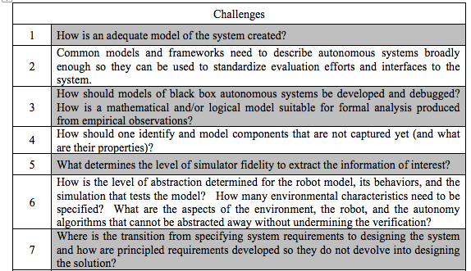
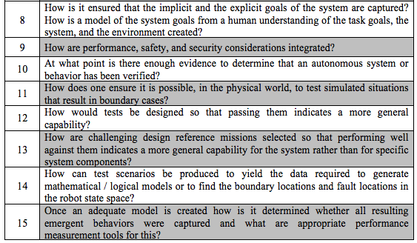
26 Research Challenges

Slide 18
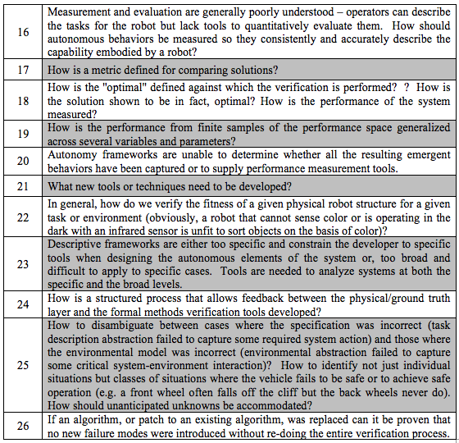
26 Research Challenges
Or are there 35?

Slide 19
Approaches to Verification
Formal Methods
Correct-by-construction Synthesis
Monte Carlo Sampling
Model Checking
Barrier Certificates
Others?

Slide 20
Offline vs. On-line Learning
Offline:
Collect data
Train model with new data
Update system with new/revised model
Perform V&V on system offline
If acceptable, field revised system
Revalidate performance continuously while operating

Slide 21
Offline vs. On-line Learning
On-line:
Collect data while operating
Train secondary model with new data
Compare secondary model with primary model
Perform V&V on revised system with secondary model
If acceptable, replace primary model with newly trained secondary model (while still operating)
Revalidate performance continuously while operating

Slide 22
Panel Introductions
Robert Fitch, Head of School (Acting)
School of Mechanical and Mechatronic Engineering
Faculty of Engineering and Information Technology
University of Technology Sydney
Will Curran, Spacecraft Systems Roboticist
NRL Code 8231 (Control Engineering)
Naval Research Laboratory
Washington, DC
Fabio Bonsignorio
Associate Editor IEEE Robotics & Automation Magazine
IROS 2018 Chair for Enterpreneurship
Visiting Professor
The BioRobotics Institute
Scuola Superiore Sant'Anna, Pisa, Italy
CEO, Heron Robotics

Slide 23
Questions for Panel and Audience
What role do you see verification (either formal or informal) playing in the advancement and adoption of autonomous systems?

Slide 24
Questions for Panel and Audience
To what extent can existing verification processes for software and for physical platforms (such as aircraft) be utilized to verify autonomous systems (excepting the inclusion of ML for now)?

Slide 25
Questions for Panel and Audience
What are the limitations going forward for simply extending existing approaches to verification, wrt autonomous systems?
Do we need radical new ideas to address verification? “Laws of Robotics” perhaps?

Slide 26
Questions for Panel and Audience
Current verification processes are different for software and for physical platforms such as aircraft. But autonomous aerial platforms include both software and physical systems. Can a single verification process serve both?

Slide 27
Questions for Panel and Audience
How can autonomous systems accurately model their own uncertainty and robustly direct their own actions to mitigate risk?

Slide 28
Questions for Panel and Audience
How should an autonomous system balance risk (due to uncertainty, either of its model or the outcome of its actions) and reward? Is this simply a parameter setting? Are there moral or ethical aspects of the resultant behavior of the autonomous system that should be constrained?

Slide 29
Questions for Panel and Audience
(Moderator) Many AI systems in commercial use now use machine learning, often in an offline mode, in order to build models such as classifiers. These AI components may then be used as part of an autonomous platform, such as for object recognition/classification in Uber’s self-driving cars.

Slide 30
Questions for Panel and Audience
What challenges does offline learning add to the verification process for autonomous systems?

Slide 31
Questions for Panel and Audience
What do you believe to be the most effective approach (or approaches) to addressing these challenges (with adding offline learning to autonomous systems)?

Slide 32
Questions for Panel and Audience
(Moderator) I assert that for artificial systems to attain ‘intelligence’ even remotely comparable to human intelligence must be able to adapt and learn on-the-fly (on-line) in difficult (i.e., unstructured, previously unknown, and dynamically changing) environments, just as humans do. Learning includes both adaptation and memory. But on-line learning presents particular challenges for verification.

Slide 33
Questions for Panel and Audience
(Moderator) If we think of humans as autonomous systems that learn, we can consider the processes currently used to verify them for performing complex tasks. Such processes often involve training (used to transfer knowledge to the humans) and testing. In addition, the humans are often constrained by rules regarding “acceptable” and “unacceptable” behavior. Autonomous humans are “allowed” to learn and adapt their behaviors as long as they don’t violate the rules.

Slide 34
Questions for Panel and Audience
Could similar techniques be developed for verification of autonomous systems that learn on-line?

Slide 35
Questions for Panel and Audience
Would this be a simple extension of methods used to verify autonomous systems that learn offline?

Slide 36
Audience Questions and Discussion
???

