Slide 1
William Curran
Naval Research Laboratory
Learning-Based Controls Researcher

Slide 2
Disclaimer
Note: I will be speaking in generalities.
There will be exceptions to everything that I say!

Slide 3
Who am I?
Reinforcement Learning Researcher

Slide 4
Who am I?
Reinforcement Learning Researcher
A fan of V&V

Slide 5
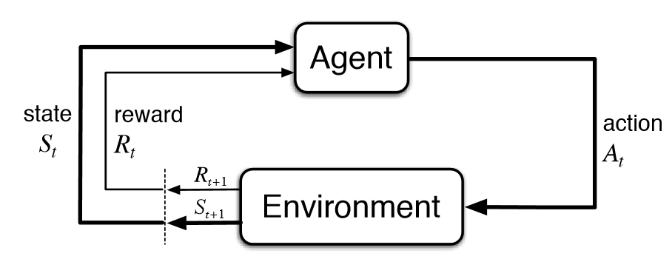
What is RL
Model-Free

Slide 6
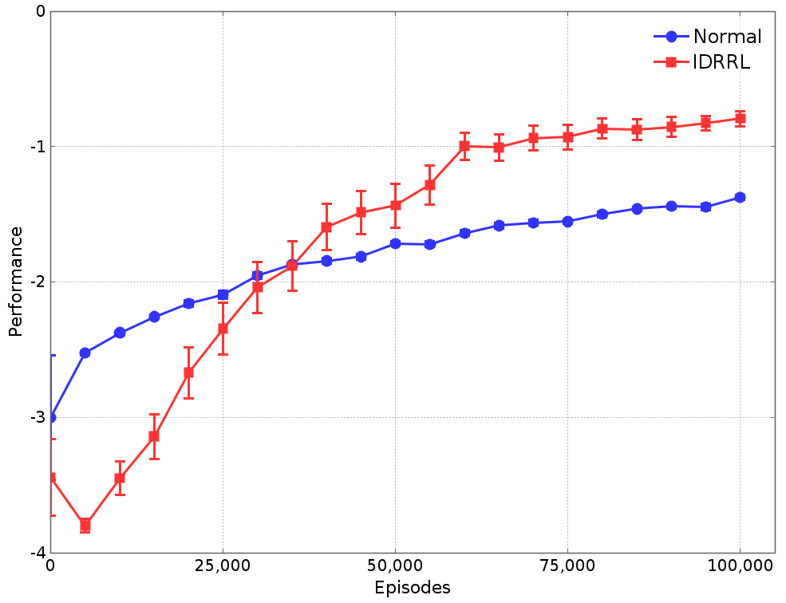
How do we report results?

Slide 7
How do we report results?
Error bars…
MY simulation
MY environment
Over 1000 trials.

Slide 8
How do we report results?
Error bars mean very little!

Slide 9
People
Physics
Animals

Slide 10
People
Physics
Animals

Slide 11
Supervisor
People
Physics
Animals

Slide 12
