Slide 1
Verification of Autonomous Systems Workshop Progress and Next Steps Discussion
Signe Redfield
May 2018
U.S. Naval Research Laboratory

Slide 2
Verification of Autonomous Systems Working Group Progress
Verification of Autonomous Systems Working Group history
Started with a meeting at NRL in 2014
Ongoing meetings, discussions through 2015
Workshops at ICRA in 2016, at IROS in 2017, and at ICRA in 2018
At the first meeting
Identified extensive list of research challenges (at one time had 35 challenges!)
Since then
Massive growth in opportunities for transition of robotic technology developed in the lab into fielded systems
Consequent massive growth in interest in verification and performance evaluation of autonomous systems
Mailing list has grown to over 100 currently valid email addresses
3 very successful workshops
Funding agencies (at least in the US And UK) have significantly increased funding available for verification of autonomous systems, in some cases for the first time
New projects have started
Publications
MOST IMPORTANT: Starting to make progress against the research challenges!
Time to take a step back from the weeds and look at the big picture

Slide 3
Discussion Topics – Next Steps?
Asking for feedback
Consensus here (if any) will be sent out to the entire group to find out whether anyone has major objections
Meetings and Group Structure
Should we be formalizing the group in any way? Maybe propose an IEEE Technical Committee?
May get us more access to IEEE collaboration resources
Workshop at ICRA in 2019?
Hold a stand-alone conference or workshop?
PerMIS?
What about a regular annual standalone working group meeting sometime in early spring?
Documentation Options
Book
Don and I would like to edit a book capturing the work that the group has done over the last few years
Web
Would it be helpful to have a group web presence?
What kind of information should it capture?
Links to new publications by the group,
Links to relevant standards and funding calls
Information about relevant conferences and workshops (including ours)
Information about related working groups
Does the group want something open, something anyone in the group can edit, or something with access restrictions?

Slide 4
Notes
IEEE TC – have webpage, get to organize and attract interested people, organize workshops – visibility of topic. Impact keywords, widespread access to the community
Standards assoc – global initiative on ethics
Working groups – discuss ethical concerns – incl transparency and accountability – technical and social points of view
Output – ethically-aligned design document; standards (transparency standard, fail safe autonomous systems standard) – opportunity to participate. Meetings/conference calls frequently – need knowledgeable contributors to provide good ideas
Book
Galen and Dejanira to contribute chapters
Meetings –
ICRA workshop in 19
PerMIS – NIST – currently planned for mid to late Oct 2019
Standalone meeting in Sept/Oct 18
Place TBD
Web site
Curated
Best use cases
Signposts, stamp of quality
Someone _responsible_ for updating
Associated with organization – update with workshop at least
Contents
People directory
Publications – including archive of seminal works and important publications
R-articles (reproducible robotics research)
Tools
Challenge progress
Funding sources
Conference/publication opportunities
Jobs

Slide 5
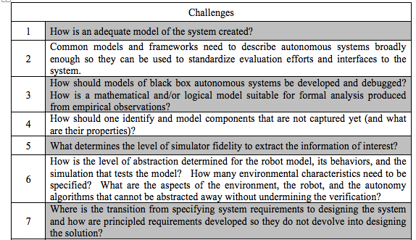
Current Challenges

Slide 6
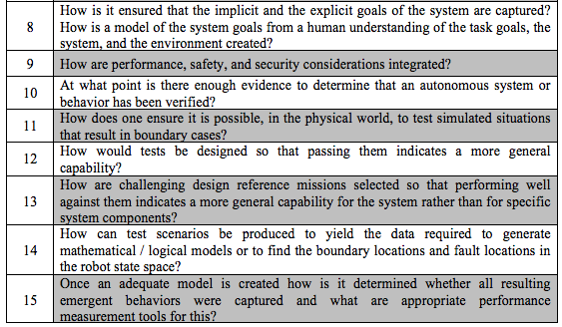
Challenges, Cont.

Slide 7
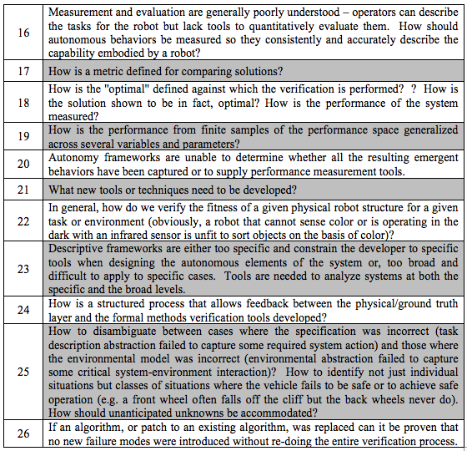
Challenges, Cont, again!

